Slide 1
Unit 2 Security

Slide 2
Learning Objectives
Moral
Achieve a thorough understanding of “security”
Reflect on security problems in today’s society
Skills
Learn to express themselves more appropriately when discussing the topic of security and safety
Learn to write cause and effect essay
language
Build up an active vocabulary around the theme of security and know how to use it in context

Slide 3
CONTENTS
Part 1
Before Reading
Part 2
In Reading
Part 3
After Reading
Part 4
Critical Thinking
Part 5
Culture Focus
Part 6
Home Reading

Slide 4
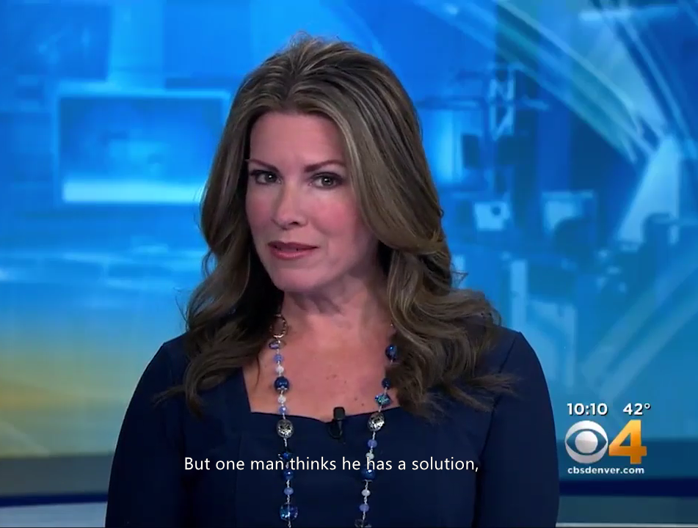
Before Reading
Neighborhood Watch Program
Watch a news video clip on a neighborhood watch (邻里联防) program prompted by fear of growing crime and complete the statements that follow according to what you have heard.

Slide 5
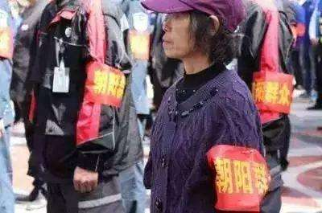
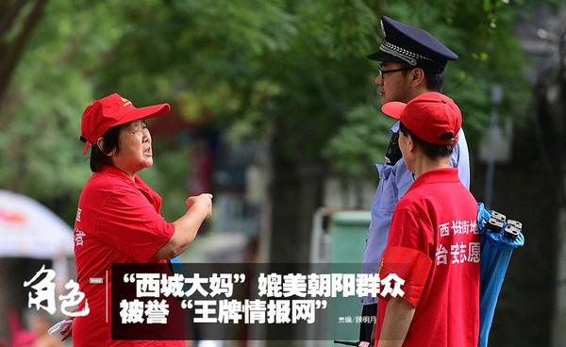
Before Reading
Neighborhood Watch Program
To keep our residential community safe, is it a good idea to encourage community members to serve as extra “eyes and ears” and report their observations of suspicious activities to local district police?

Slide 6
Before Reading
fight against hidden crimes
police resourses
violent/severe crimes
disclose criminal cases
take drugs/ask for prostitution
take preventive measures
feel uncomfortable

Slide 7
Before Reading
Word Review
fight against
the crime of killing sb deliberately/illegally but not deliberately
develop quickly
feel uspet and anxious
place, venue
cut back, lessen
records of being arrested in a police district

Slide 8
Before Reading
Word Review
stimulate, motivate
friendly, be willing to offer help
the crime of entering a building illegally and stealing things from it
connected with or involving crime; a person who commits a crime
pay close attention to
(a situation, plan) makes sb. feel unwell and unacceptable
do the things somebody else has already done before

Slide 9
Before Reading
Blank Filling
1. A series of violent crimes near Denver’s Sloan’s Lake has made people in the neighborhood _________ .
2. A.J. Steinkee, a local citizen, says crime is at an __________ in the Sloan’s Lake area and that the area has become a hot spot for crime.
3. Yet just to the north in Harkness Heights, the situation is very different because of their neighborhood watch program, which _________________________________.
4. A. J. Steinkee thinks the Sloan’s Lake area can follow the example of Harkness Heights, so he encourages his neighbors to get to know one another so they can watch out for anything or anyone _________.
nervous
all-time high
helps to prevent crimes from taking place
suspicious

Slide 10
Before Reading
Review
the crime of killing sb deliberately/illegally but not deliberately
connected with or involving crime; a person who commits a crime
feel uspet and anxious
violent/severe crimes; minor/petty crimes
drug-taking, burglary, kidnapping, robbery, trafficking, terrorism activities, murder, money laundering, sabotage
embezzlement of public funds, forgery, fraud theft, stealing

Slide 11
Before Reading
Brainstorm
1. What’s security? What’re kinds of security problems?
national, homeland, political, economical,financial, military, cultural, technological, ecological, information, internet/cyber
维护国家安全
keep/protect/safeguard national security
国家安全战略
national security strategy
国家安全制度体系
national security systems and institutions

Slide 12
Before Reading
Brainstorm
习近平强调，国家安全工作是党治国理政一项十分重要的工作，也是保障国泰民安一项十分重要的工作。做好新时代国家安全工作，要坚持总体国家安全观。
——2020年12月11日，习近平在主持中央政治局第二十六次集体学习时发表重要讲话
Noting the importance of national security work to the Party's governance of the country and to bringing prosperity and security to the nation and the people, Xi stressed pursuing a holistic approach to national security in order to carry out the national security work well in the new era.
Political Bureau of the Central Committee of the CPC
Communist Party of China
Back

Slide 13
Before Reading
2021.12 井冈山、延安、中国共产党第一次全国代表大会
2021.6 青海、海南、云南
2020.12 青藏铁路、北京大兴国际机场、港珠澳大桥
2020.9 红楼梦、西游记、水浒传
中国共产党第一次全国代表大会会址位于上海兴业路76号，是一栋典型的上海式住宅，建于1920年秋。1921年7月23日，中国共产党第一次全国代表大会在此召开，大会通过了中国共产党的第一个纲领和第一个决议，选举产生了中央领导机构，宣告了中国共产党的诞生。1952年9月，中共一大会址修复，建立纪念馆并对外开放。纪念馆除了介绍参加一大的代表以外，还介绍党的历史发展进程，现已成为了解党史、缅怀革命先烈的爱国主义教育基地。

Slide 14

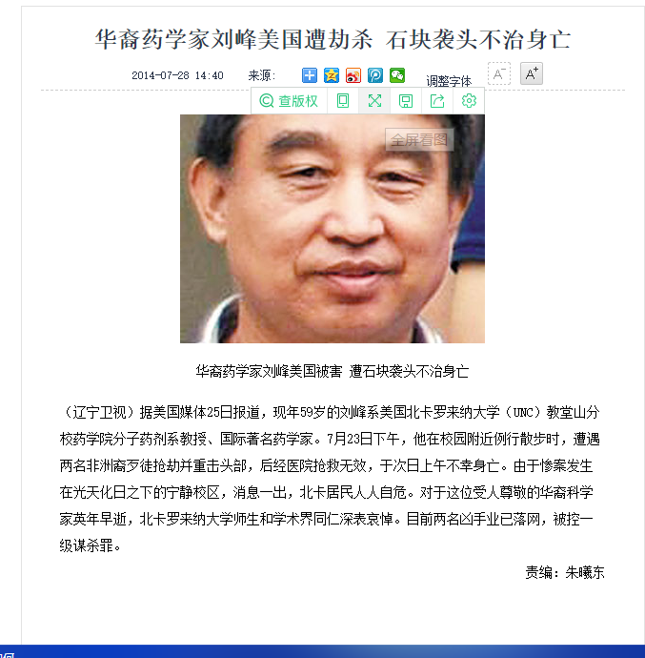
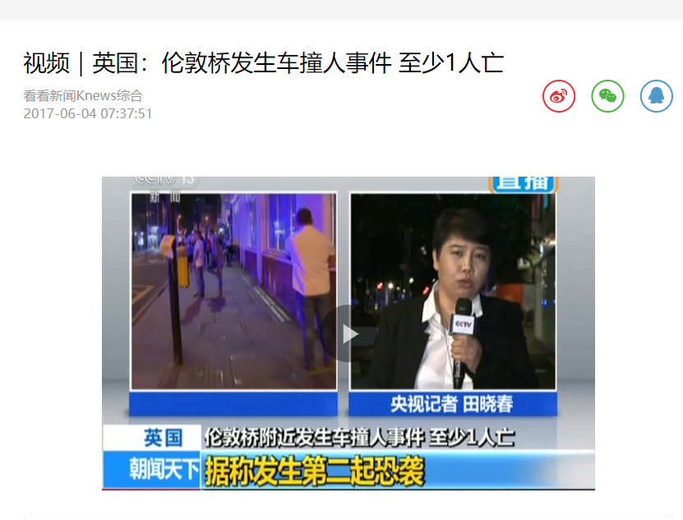
Before Reading
Brainstorm
2. Is it safe in China? in the USA? in the United Kindom?
Back

Slide 15
Before Reading
legal rights to hold guns
gun violence
strong leadership of government
effective security measures
different national characters
obedient vs rebellious
individualism vs collectivism
pursue individual freedom
sacrifice individual interests to group interests

Slide 16
Before Reading
Brainstorm
3. Have you ever encountered some security problems so far? If so, what are they? Burglaries or petty thefts or anything else? What did you do to solve the problem at that time?
Back

Slide 17
Before Reading
4. What tips will you give to the people in order to protect themselve from being stolen, robbed or kidnapped or some other dangerous situations?
avoid walking or running alone at night,go with a friend
no using headphones while walking, driving or jogging
always walk in well-lighted areas
avoid the use of short cuts
keep away from large bushes or doorways where someone could be lurking after dark

Slide 18
Before Reading
always stay near the curb
If someone in a vehicle stops and asks for directions, answer from a distance. Do not approach the vehicle.
If followed, go immediately to an area with lights and people.
If need be, turn around and walk in the opposite direction
Do not display cash openly, especially when leaving an ATM

Slide 19
In Reading
Global Reading
Detailed Reading
Back

Slide 20
In Reading
Global Reading
learning new vocabulary or structures
looking for useful information
identifying keywords: Lock
Scan the text to find all the sentences containing the word “lock” or the word with “lock” as its root.
Back

Slide 21
In Reading
1) … doors do not stay unlocked (Para. 2)
2)… a picture of a child’s bicycle with the now-usual
padlock attached to it. (Para. 6)
3) The lock is a new symbol of America. (Para. 6)
4) … the transformation of America from the Land of the Free to the Land of the Lock. (Para. 7)
5) … we devise ways to lock the fear out. (Para. 16)
6) We may have locked the evils out, but in so doing we have locked ourselves in. (Para. 18)

Slide 22

In Reading – Global Reading
Part Division of the Text
Parts
Para(s)
Main Ideas
In America, the era of leaving the front door on the latch has drawn to a close.
1
1~3
2
4~15
A new atmosphere of fear and distrust creeps into every aspect of daily life. As a result, security devices, in varied forms, are put to use.

Slide 23
In Reading – Global Reading
Part Division of the Text
Parts
Para(s)
Main Ideas
3
16~19
By locking our fears out, we become prisoners of our own making.
Back

Slide 24
In Reading – Global Reading
Pair Work
1. In the author’s boyhood, did he have to carry keys with him if he stayed out late at night?
No.
2. Do people nowadays keep up the custom o leaving the front door on the latch at night?
No.

Slide 25
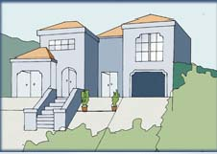

In Reading – Detailed Reading
THE LAND OF THE LOCK
Bob Greene
1 In the house where I grew up, it was our custom to leave the front door on the latch at night. I don’t know if that was a local term or if it is universal; “on the latch” meant the door was closed but not locked. None of us carried keys; the last one in for the evening would close up, and that was it.
2 Those days are over. In rural areas as well as in cities, doors do not stay unlocked, even for part of an evening.

Slide 26
In Reading – Global Reading
Pair Work
3. What has taken the place of the era when people could safely keep their front door unlocked?
It has been replaced by an era when people employ various security devices at home.

Slide 27
In Reading – Detailed Reading
3 Suburbs and country areas are, in many ways, even more vulnerable than well-patroled urban streets. Statistics show the crime rate rising more dramatically in those allegedly tranquil areas than in cities. At any rate, the era of leaving the front door on the latch is over.
4 It has been replaced by dead-bolt locks, security chains, electronic alarm systems and trip wires hooked up to a police station or private guard firm. Many suburban families have sliding glass doors on their patios, with steel bars elegantly built in so no one can pry the doors open.

Slide 28
In Reading – Global Reading
Pair Work
4. What can be commonly seen pasted on the windows of the most pleasant of homes?
Small notices announcing that the premises are under surveillance by this security force or that guard company.

Slide 29
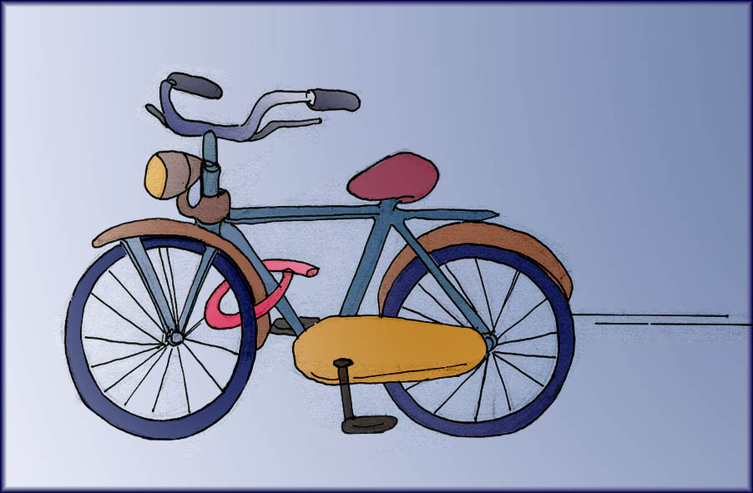
In Reading – Detailed Reading
5 It is not uncommon, in the most pleasant of homes, to see pasted on the windows small notices announcing that the premises are under surveillance by this security force or that guard company.
6 The lock is the new symbol of America. Indeed, a recent public-service advertisement by a large insurance company featured not charts showing how much at risk we are, but a picture of a child’s bicycle with the now-usual padlock attached to it.

Slide 30
In Reading – Global Reading
Pair Work
5.What is the insurance company’s intention of running an ad with a picture showing a padlock attached to a kid’s bicycle?
The insurance company tries to impress the public that it will ensure your safety by paying for your losses.
6. What does the author think is the new atmosphere of American life?
An atmosphere of fear and distrust.

Slide 31
In Reading – Detailed Reading
7 The ad pointed out that, yes, it is the insurance companies that pay for stolen goods, but who is going to pay for what the new atmosphere of distrust and fear is doing to our way of life? Who is going to make the psychic payment for the transformation of America from the Land of the Free to the Land of the Lock?
8 For that is what has happened. We have become so used to defending ourselves against the new atmosphere of American life, so used to putting up barriers, that we have not had time to think about what it may mean.
9 For some reason we are satisfied when we think we are well-protected; it does not occur to us to ask ourselves: Why has this happened?

Slide 32
In Reading – Global Reading
Pair Work
7. Why do big American companies demand that their employees pass in and out of their work place with an access card?
Because they feel threatened and want to keep oursiders away.

Slide 33
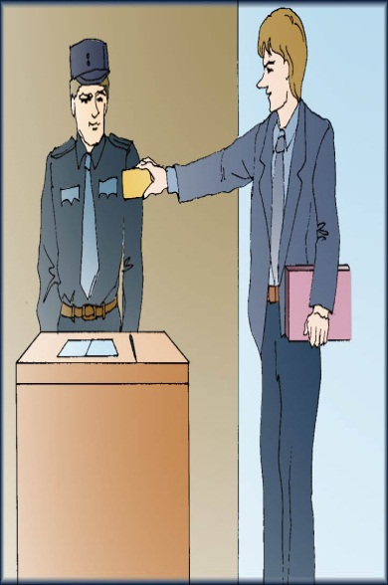
In Reading – Detailed Reading
Why are we having to barricade ourselves against our neighbors and fellow citizens, and when, exactly, did this start to take over our lives?
10 And it has taken over. If you work for a medium- to large-size company, chances are that you don’t just wander in and out of work. You probably carry some kind of access card, electronic or otherwise, that allows you in and out of your place of work. Maybe the security guard at the front desk knows your face and will wave you in most days, but the fact
remains that the business you work for feels threatened enough to keep outsiders away via these “keys.”

Slide 34
In Reading – Global Reading
Pair Work
8. Are airports still a place of education and fun today?Why or why not?
No. They are by now the most sophisticated of security sites.
9.What function do people think electronic X-ray equipment can perform now at airport security?
It is a way to hold the terrorists, real and imagined, at bay.

Slide 35
In Reading – Detailed Reading
11 It wasn’t always like this. Even a decade ago, most private businesses had a policy of free access. It simply didn’t occur to managers that the proper thing to do was to distrust people.
12 Look at the airports. Parents used to take children out to departure gates to watch planes land and take off. That’s all gone. Airports are no longer a place of education and fun; they are the most sophisticated of security sites.
13 With electronic X-ray equipment, we seem finally to have figured out a way to hold the terrorists, real and imagined, at bay; it was such a relief to solve this problem that we did not think much about what such a state of affairs says about the quality of our lives.

Slide 36
In Reading – Global Reading
Pair Work
10. Why are businessmen buying new machines to analyze a telephone caller’s voice?
To tell whether their friend or client is telling lies.
11. Under what excuse do people resort to all those means mentioned in Part 2? Does the author think they are justified in doing so?
In the name of “security”. In the author’s opinion, America becomes the most insecure nation with all these means.

Slide 37
In Reading – Detailed Reading
We now pass through these electronic friskers without so much as a sideways glance; the machines, and what they stand for, have won.
14 Our neighborhoods are bathed in high-intensity light; we do not want to afford ourselves even so much a luxury as a shadow.
15 Businessmen, in increasing numbers, are purchasing new machines that hook up to the telephone and analyze a caller’s voice. The machines are supposed to tell the businessman, with a small margin of error, whether his friend or client is telling lies.
16 All this is being done in the name of “security”; this is what we tell ourselves. We are fearful, and so we devise ways to lock the fear out, and that, we decide, is what security means.

Slide 38
In Reading – Detailed Reading
Pair work
12. According to the author, what may be the legacy we remember best when we recall this era?
We may have locked the evils out, but in so doing we have locked ourselves in.

Slide 39
In Reading – Detailed Reading
17 But no; with all this “security,” we are perhaps the most insecure nation in the history of civilized man. What better word to describe the way in which we have been forced to live? What sadder reflection on all that we have become in this new and puzzling time?
18 We trust no one. Suburban housewives wear rape whistles on their station wagon key chains. We have become so smart about self-protection that, in the end, we have all outsmarted ourselves. We may have locked the evils out, but in so doing we have locked ourselves in.

Slide 40
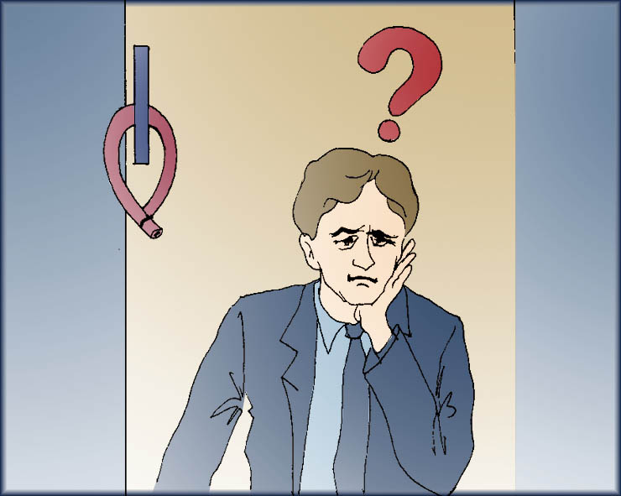
In Reading – Detailed Reading
19 That may be the legacy we remember best when we look back on this age: In dealing with the unseen horrors among us, we became prisoners of ourselves. All of us prisoners, in this time of our troubles.

Slide 41
In Reading – Detailed Reading
Further Understanding Questions
1. In the text, the author uses some supporting facts to explain his central idea: America has deteriorated from the Land of the Free to the Land of the Lock. Find the supporting facts and write them down.
1) In rural areas as well as cities, doors are not left unlocked, even for part of an evening.
2) Dead-bolt locks, security chains, electronic alarm systems and trip wires are widely in use.
3) Suburban families have steel bars built in sliding glass doors so no one can pry them open.

Slide 42
In Reading – Detailed Reading
Further Understanding Questions
4) Notices warning against burglary are seen pasted on the windows of some most pleasant houses.
5) Access cards are required of those who work with medium- to large-size companies.
6) Airport security uses electronic X-ray equipment to guard against terrorism.
7) Businessmen employ new machines hooked up to their telephone to help determine whether the caller is telling lies.
8) Suburban housewives wear rape whistles on their key chains in case they are needed.

Slide 43
In Reading – Detailed Reading
Further Understanding Questions
2. How does the author go back and forth between the past and the present in narrating the story? Never for once does he write “in the past” or “at present” explicitly. He has used some clever devices. What are they?
a subtle tense change ( simple past VS present perfect)
a phrase indicating and old habit VS a phrase indicating the current state (used to VS no longer Para.12)
a summary sentence (“ It wasn’t always like that” Para.12)

Slide 44


In Reading - Language Focus
on the latch
(of a door) closed but not locked（门）关着但没上锁
Don’t forget to leave the front door on the latch if you go to bed before I get back.
你如果在我回来之前就上床睡觉，别忘了给我留着前门不要上锁。
Back

Slide 45
In Reading - Language Focus
close up
shut sth. that is open 关闭
He closed up the house when he went on holiday.
他去度假的时候把房子所有的门窗都关上了。
Rather than lose money, it would be better to close up the business.
与其赔钱，不如歇业。
Back

Slide 46
In Reading - Language Focus
rural a.
of, in or suggesting the countryside 农村的；有乡村特点的
The area is still very rural and underdeveloped.
这个地区仍是一片乡村景象，没有开发。
Back

Slide 47
In Reading - Language Focus
vulnerable a.
exposed to danger or attack; unprotected 易受攻击的；无防御的
Doctors say that older people are more vulnerable to this new virus.
医生们说年纪大的人更容易被这个新病毒感染。
Back

Slide 48
In Reading - Language Focus
statistics n.
numerical facts or data; the science dealing with the collection, classification, analysis, and interpretation of numerical data 统计数据；统计学
According to official statistics, the Japanese work longer hours than workers in most other industrialized countries.
根据官方统计数据，日本人比其他大多数工业化国家工人的工作时间都要长。
Back

Slide 49
In Reading - Language Focus
hook up to
connect or attach (sth.) to (sth. else) with or as if with a hook 连接到
Can we hook up to the electricity supply at the campsite?
我们的露营地能接通电吗？
Back

Slide 50
In Reading - Language Focus
build in
construct as an integral part of a larger structure 建成为建筑物的一部分
A wardrobe with mirrored doors was built in so as to make their small bedroom look larger.
为了使他们的小卧室看上去大一点，他们建了一个带镜子的嵌入式衣橱。
Back

Slide 51
In Reading - Language Focus
pry
1) vt. pull apart with a lever 撬开；撬动
They tried to use an iron bar to pry open the lock.
他们试图用一根铁棒撬开锁。
2) vi. （pry into sth.）look or inquire closely and curiously 探听，打听，探查（隐私）
Don’t pry into the affairs of others.
不要多管闲事。
Back

Slide 52
In Reading - Language Focus
paste
1) vt. cause to adhere by or as if by paste（用浆糊）粘贴
Cut that paragraph and then paste it at the end of the page.
将那一段剪切下来，粘贴到页尾上。
2) n. 浆糊；糊状物
Add water to the flour and mix it into a paste.
在面粉里加些水并搅成糊状
Back

Slide 53
In Reading - Language Focus
premises n. (pl.)
a house or building, together with its land（包括地基在内的）房屋或建筑物
No smoking is allowed anywhere on school premises.
校区内任何地方都禁止吸烟。
Back

Slide 54
In Reading - Language Focus
feature
1) vt. give a prominent part to (sb./sth.) 以……为重点
The newspaper featured the story of the event.
报纸为那个事件做了个专题报道。
2) n. a prominent or distinctive aspect, quality, or characteristic 特色，特征，特点
The spacious gardens are a special feature of this property.
宽敞的花园是这处房产的一大特色。
Back

Slide 55
In Reading - Language Focus
barrier n.
a fence or other obstacle that prevents movement or access 障碍；壁垒
Despite the language barrier, they soon became good friends.
尽管语言上存在障碍，他们还是很快就成了好友。
Back

Slide 56
In Reading - Language Focus
barricade
1) vt. obstruct or block with a barricade 设置路障
The local residents barricaded the main road with fallen trees.
当地居民用倒下的树堵住了主干道。
2) n. a barrier that obstructs passage 路障，街垒
Large areas of the city have been closed off by barricades.
该市大片地区已经用路障隔开了。
Back

Slide 57
In Reading - Language Focus
take over
assume control of sth. 取得…的控制权
It would be up to them to decide who should take over and whether they should let an outsider run the company.
将由他们自己决定谁来接管，以及是否应让外人管理公司。
Back

Slide 58
In Reading - Language Focus
(the) chances are …
it is very likely that … 很有可能…
Chances are the interviewer will ask what you know about the company.
面试官很有可能会问你对他们公司有何了解。
Back

Slide 59
In Reading - Language Focus
hold/keep sb./sth. at bay
prevent sb./sth. dangerous or unpleasant from happening or from coming too close 使…不能接近
Some people never seem to get sick. What are they doing that the rest of us aren’t to keep illness at bay?
有些人似乎从来不生病。他们做了些什么把疾病拒之门外，而我们却没做呢？
Back

Slide 60
In Reading - Language Focus
without/with not so much as
with not even 甚至连…都没有
She left the city where she had lived all her life without so much as a backward glance.
她头也不回地离开了自己生活了一辈子的城市。
Back

Slide 61
In Reading - Language Focus
sideways ad.,a.
to, towards or from the side 向一边（的）；斜着（的）
We moved the table sideways to make more room.
我们把桌子往边上挪了挪，腾出更多空间。
The lady in red in the back row, a sideways move to the left, and I can get you in the picture.
后排穿红色的那位女士，如果你能向左移一点儿，我就可以把你拍进照片里了。
Back

Slide 62
In Reading - Language Focus
stand for
represent; mean 代表；表示，象征
It is often said that different colors can arouse different feelings and stand for different moods.
人们常说，不同的颜色给人不同的感觉、代表不同的心情。
Back

Slide 63
In Reading - Language Focus
be bathed in
be covered or enveloped as if with liquid 沉浸于，沐浴于
The city was bathed in shades of gold and silver in the afternoon.
午后，城市沐浴在金色和银色的光辉里。
Back

Slide 64
In Reading - Language Focus
with/by a small/large margin
小/大幅度地
The Democrats are ahead in the election by a small margin.
民主党以微弱优势在选举中领先。
Back

Slide 65
In Reading - Language Focus
devise vt.
plan or invent a new way of doing sth. 想出，策划，发明
The government devised a scheme for redeveloping the city center.
政府制定了市中心重建计划。
Back

Slide 66
In Reading - Language Focus
civilize vt.
bring to a stage of more advanced social and cultural development 使开化；使文明
The governors of ancient Rome wanted to civilize its citizens through education.
古罗马的统治者想要通过教育来教化全罗马的公民。
Punctuality is a necessary habit in all public affairs of a civilized society.
在文明社会的一切公众事务中，准时是一个必不可少的习惯。
Back

Slide 67
In Reading - Language Focus
look back (on/to sth.)
think about (sth.) in one’s past 回顾
When I look back I can see where we went wrong.
回过头来看，我可以看出我们错在哪里。
Back

Slide 68

In Reading - Language Focus
It is not uncommon, in the most pleasant of homes, to see pasted on the windows small notices announcing that the premises are under surveillance by this security force or that guard company.
What can be commonly seen pasted on the windows of the most pleasant homes?
Small notices warning against burglary are commonly seen pasted on the windows of the most pleasant of homes.
Back

Slide 69
In Reading - Language Focus
Indeed, a recent public-service advertisement by a large insurance company featured not charts showing how much at risk we are, but a picture of a child’s bicycle with the now-usual padlock attached to it.
What is the insurance company’s intention of running an ad with a picture showing a padlock attached to a kid’s bicycle?
The insurance company wants to show what danger people are in now because they may even get the kid’s bicycle stolen.
Back

Slide 70


In Reading - Language Focus
It simply didn’t occur to managers that the proper thing to do was to distrust people.
1. Paraphrase the structure “It occurs to sb. that …”
sb. gets the idea that …
It suddenly occurred to me that we could use a computer to do the job.
我突然意识到可以用电脑来做这个工作。
2. Translate the sentence into Chinese.
那时的管理人员从未想到不相信他人才是正道。
Back

Slide 71
In Reading - Language Focus
We seem finally to have figured out a way to hold the terrorists, real and imagined, at bay.
Paraphrase the sentence.
Finally, we found the way to keep away the terrorists, no matter whether they are real or imagined in our mind.
Back

Slide 72
In Reading - Language Focus
The machines are supposed to tell the businessman, with a small margin of error, whether his friend or client is telling lies.
Paraphrase the sentence.
The machines are thought to be able to tell the businessman whether his friend or client is telling lies with little probability of making mistakes.
Back

Slide 73
In Reading - Language Focus
All this is being done in the name of “security”; that is what we tell ourselves.
1. Why does the author use the quotation marks?
This is not real security. People are living in the illusion that they are properly protected by these security means.
2. Translate the sentence into Chinese.
所有这一切都是以“安全”的名义实施的；我们是这么跟自己说的。
Back

Slide 74
In Reading - Language Focus
We have become so smart about self-protection that, in the end, we have all outsmarted ourselves.
1. Explain “we have all outsmarted ourselves.”
“Outsmart” means “gain the advantage over by cunning or cleverness”. “We have all outsmarted ourselves” means “our cunning and cleverness result in our own disadvantage.”
2. Translate the sentence into Chinese.
我们在自我防卫方面变得如此聪明, 最终全都聪明反被聪明误。
Back

